Slide 1
Introduction

Slide 2
What is programing ?
Computer Programming is both an Art and a Science. As an art, programming takes creativity and problem-solving.
Programming is writing computer code to create a program, to solve a problem. Programs are created to implement algorithms. Algorithms can be represented as pseudocode or a flowchart, and programming is the translation of these into a computer program.

Slide 3
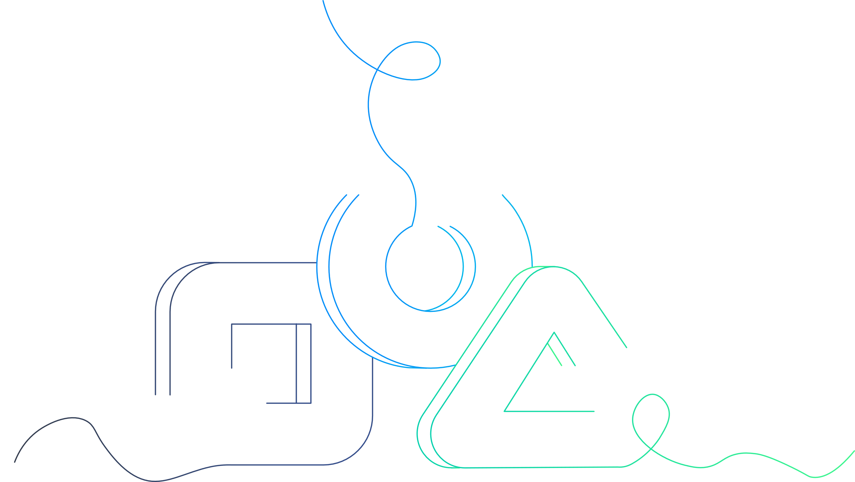
Types of programming
Web
System
Mobile
Game
Database
Scientific
Artificial Intelligence (AI) and Machine Learning (ML)
Data Science
IoT

Slide 4
Web software development
1
2
3
Planning
Design
Development

Slide 5
Web software development
4
5
6
Testing
Deployment
Maintenance

Slide 6
Web programming
It is the development of websites, web applications, and dynamic web pages using technologies such as HTML, CSS, JavaScript, and others.
Types of web programming
Web Programming
Full-stack programming
Front-end programming
Back-end programming

Slide 7
Front-End programming
Front-end programming refers to the part of web development that deals with the visual and interactive elements of a website or web application.
It involves the use these technologies
FrontEnd
HTML
JavaScript
CSS

Slide 8
BackEnd programming
Backend refers to the server-side of a web application, responsible for handling data storage, processing, and retrieval. The backend is responsible for handling requests from the front-end, and providing the necessary data and information to support the user-facing part of the application.
It involves the use these languages
Backend
Java
NoSQL
Python

Slide 9
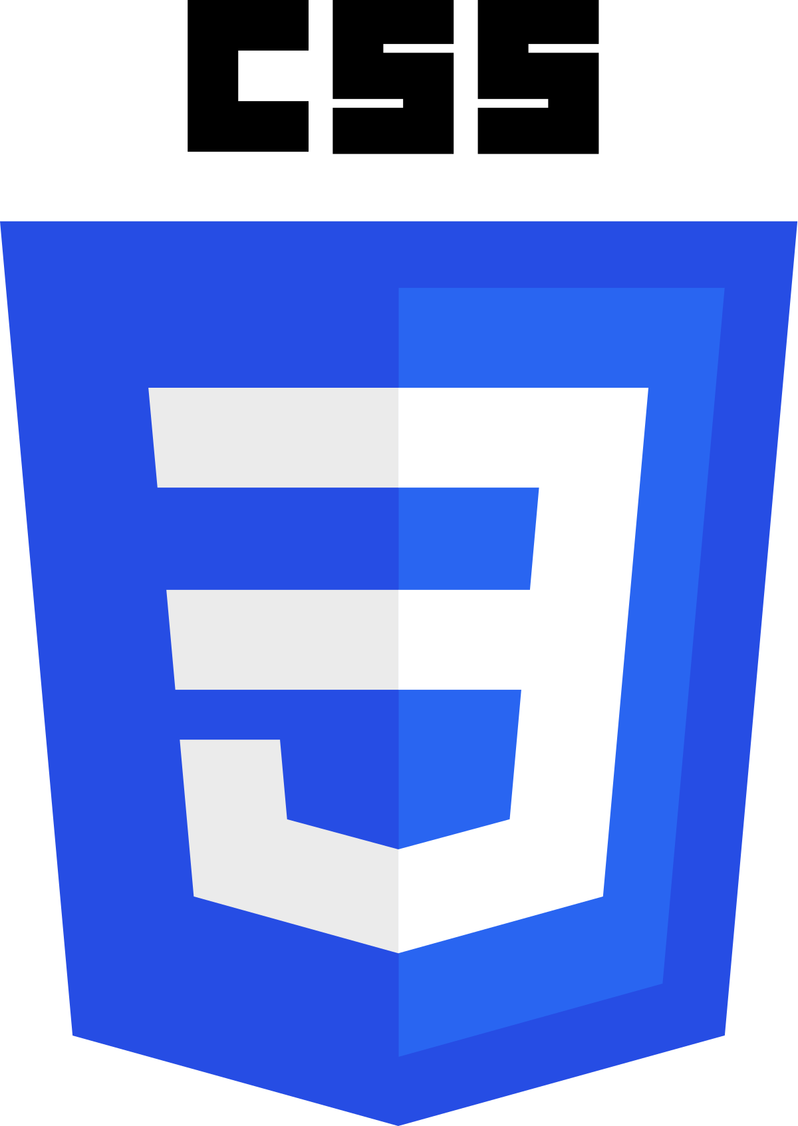
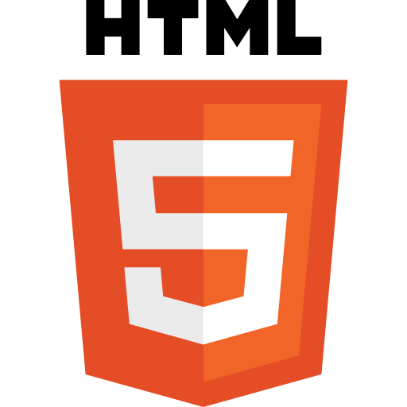
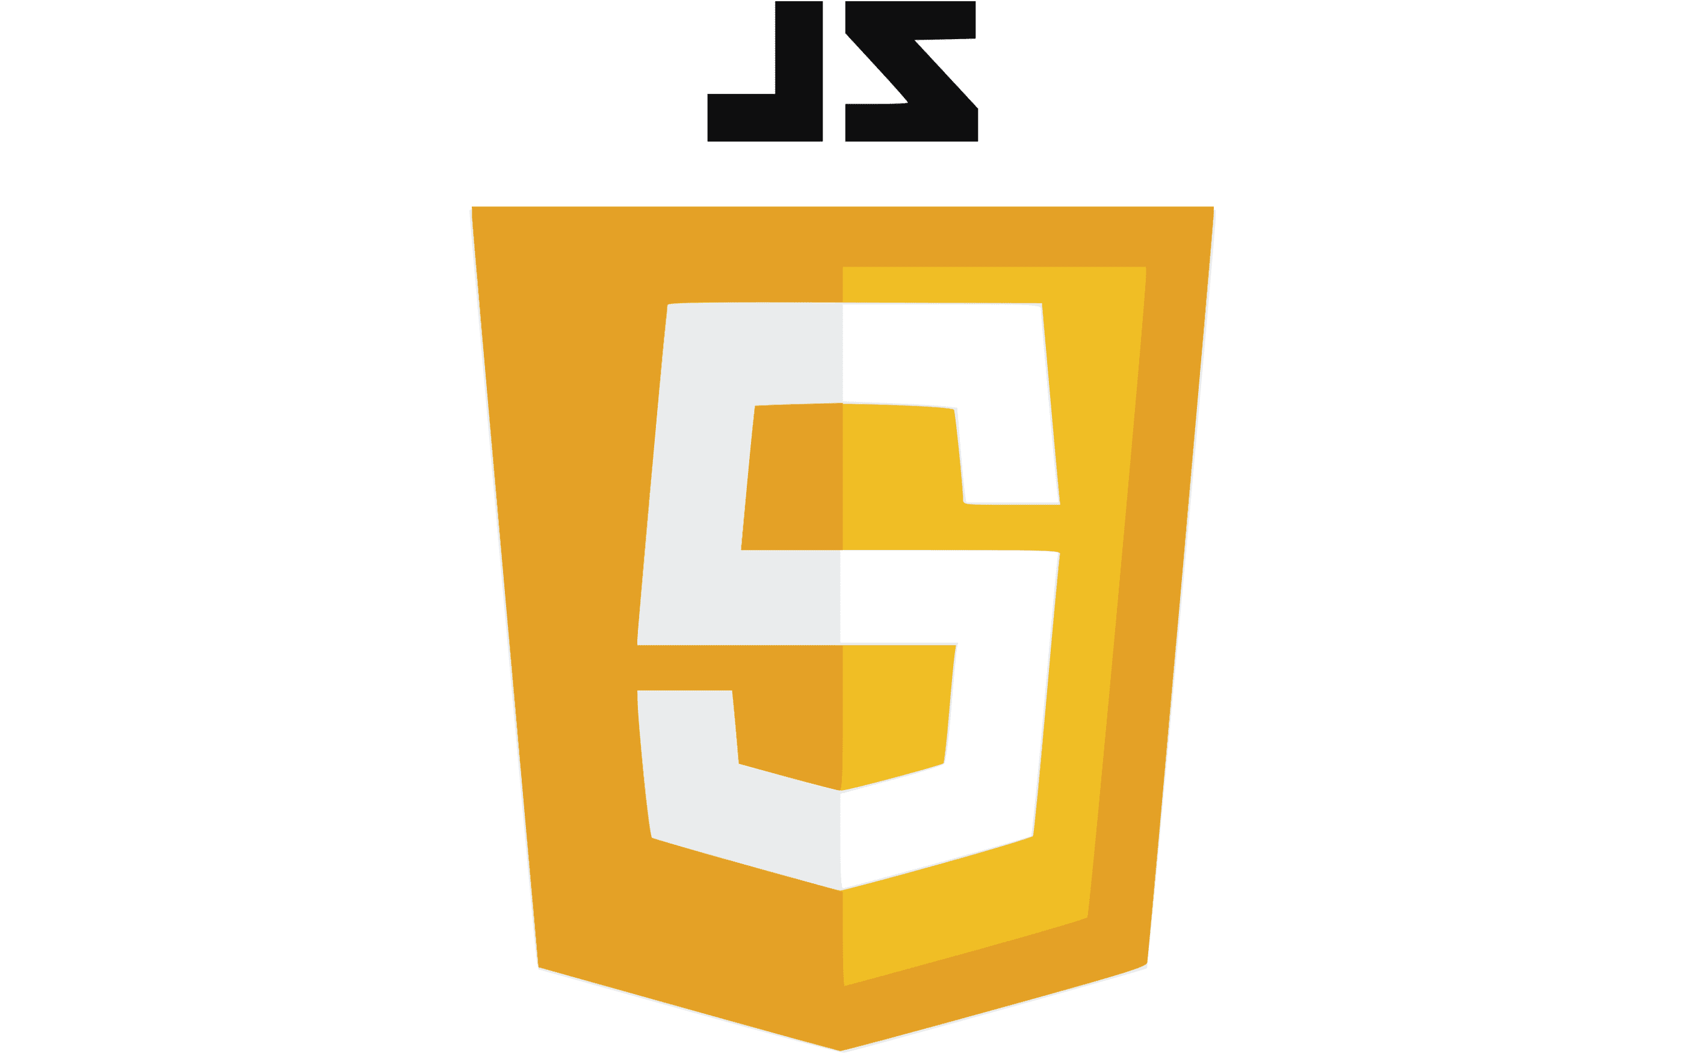

Introductions for today

Slide 10
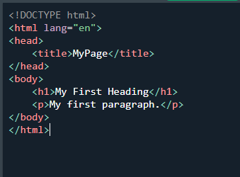
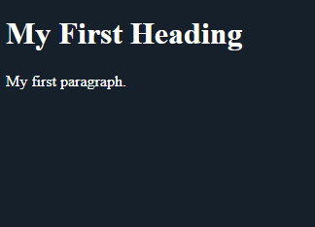
Intro to HTML
HTML (Hyper Text Markup Language) is a standardized markup language used to create and structure web pages. It provides the structure and content of a web page, including text, images, links, and other elements.

Slide 11
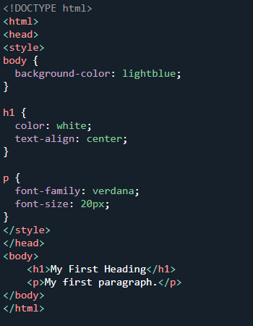
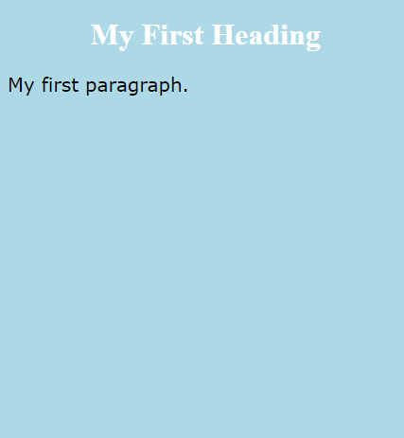
Intro to CSS
CSS (Cascading Style Sheets) is a style sheet language used for describing the look and formatting of a web page or document written in HTML. CSS (Cascading Style Sheets) is a style sheet language used for describing the look and formatting of a web page or document written in HTML.

Slide 12
Intro to JavaScript
JavaScript is a high-level, dynamically typed, and interpreted programming language used for creating interactive and dynamic web pages and web applications. It is widely used for client-side scripting and runs in the browser, making it possible to create dynamic user interfaces, interact with web services, and implement complex logic on the client side.
See what we can do with JavaScript

Slide 13
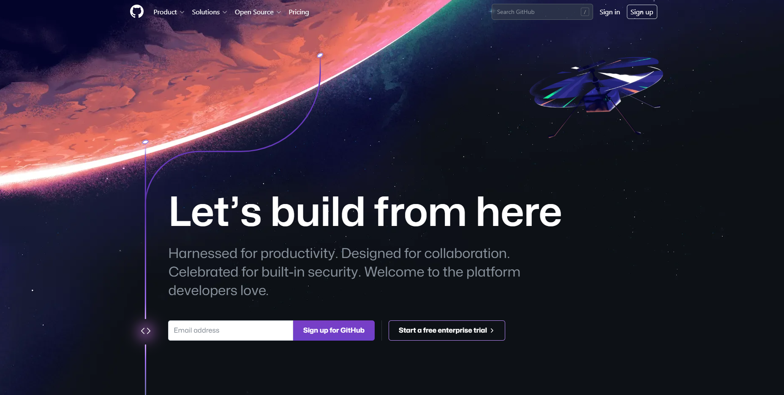
Intro to GitHub
GitHub is a web-based platform that provides hosting for software development version control using Git. It is used by individuals and organizations to store, manage, and collaborate on projects, both open-source and proprietary.
Crtl + click to visit GitHub

Slide 14
THANK YOU!

